Slide 1
appendix project 1 research paper
Braden Anderson
Ds6372 applied statistics

Slide 2
Table 1
Variable Name | Data Type | Description
MSRP | Numeric | The response variable.
Car Make | Factor | The company that made the car. Ex: Honda, Toyota, etc.
Car Model | Factor | The model of the car. Ex: 4Runner, Accord, etc.
Year | Numeric or Factor | Year the car was produced.
Engine Fuel Type | Factor | Type of fuel the car accepts. Ex: Regular unleaded, Premium unleaded, Diesel.
Engine HP | Numeric | Horsepower of the car’s engine.
Engine Cylinders | Numeric or Factor | Number of cylinders in the car’s engine.
Transmission Type | Factor | Type of transmission in the car. Usually manual or automatic, but there are a few other transmission types in the data.
Driven Wheels | Factor | The wheels that are powered by the engine. Ex: Front wheel, rear wheel, four wheel drive.
Number of Doors | Numeric or Factor | The number of doors that the car has.
Market Category | Factor | Various special descriptors for each car. Ex: Exotic, Luxury, High-Performance.
Vehicle Size | Factor | Description of the vehicles size. Ex: Midsize, Large, Compact.
Vehicle Style | Factor | Body type of the vehicle. Ex: Coupe, Convertible, etc.
Highway MPG | Numeric | Fuel efficiency on the highway in MPG.
City MPG | Numeric | Fuel efficiency in the city in MPG.
Popularity | Numeric | A popularity score for each car. Derived from social media sentiment, however the dataset does not provide specifics on how this is calculated.

Slide 3
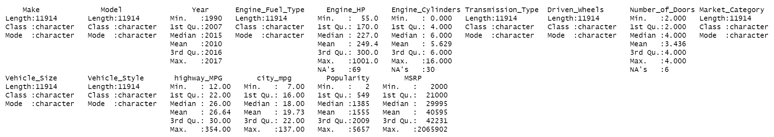
Table 2
Summary stats prior to data cleaning

Slide 4
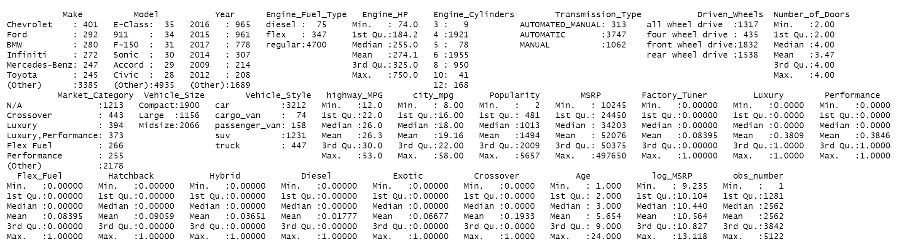
Table 3
Summary stats after data cleaning

Slide 5
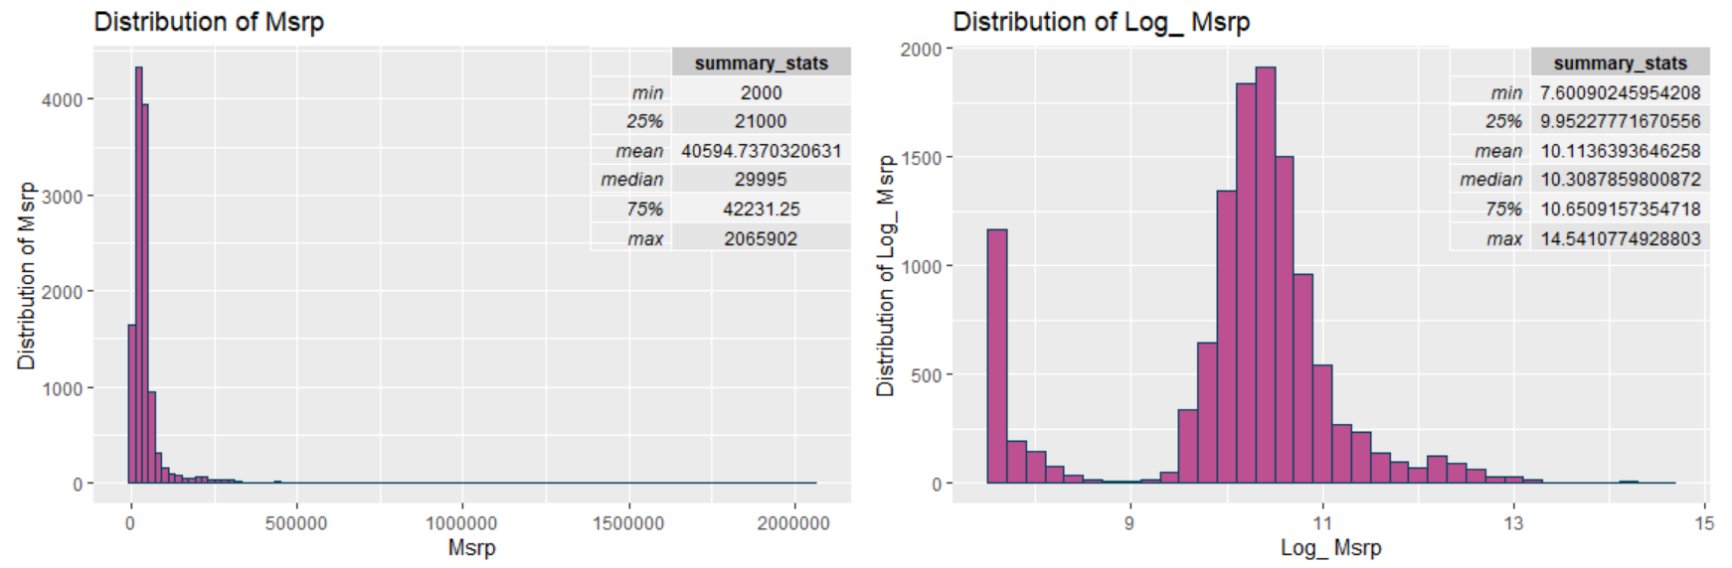
Figure 1: MSRP and log transformed version before data cleaning

Slide 6
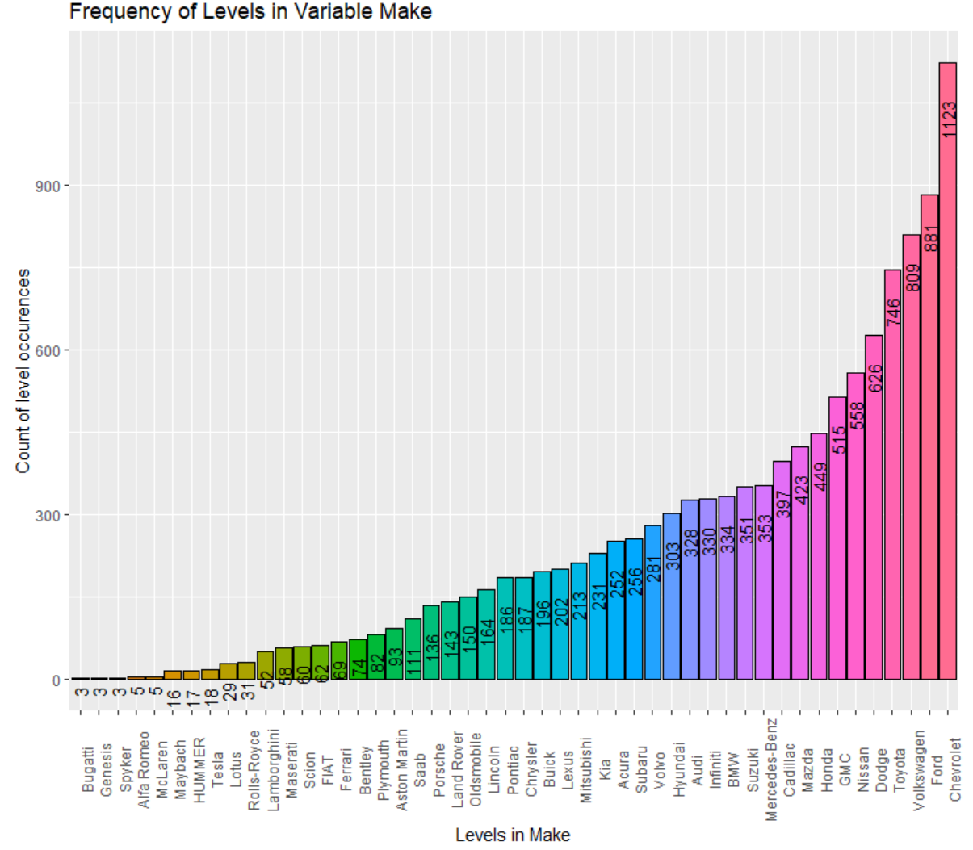
Figure 2: Count plot of Make before data cleaning

Slide 7
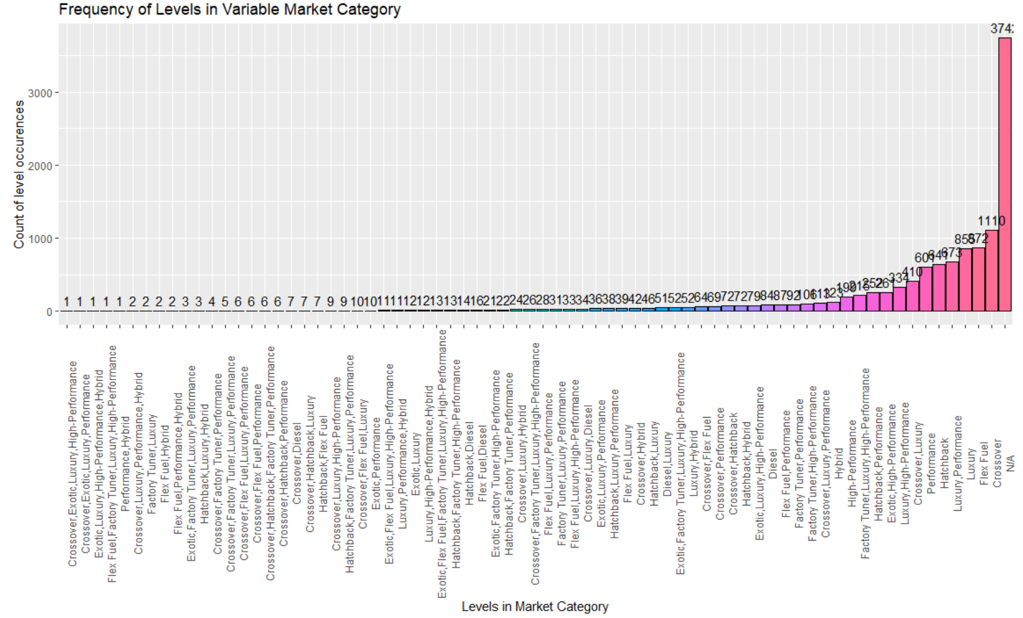
Figure 3: Count plot of Market Category before data cleaning

Slide 8
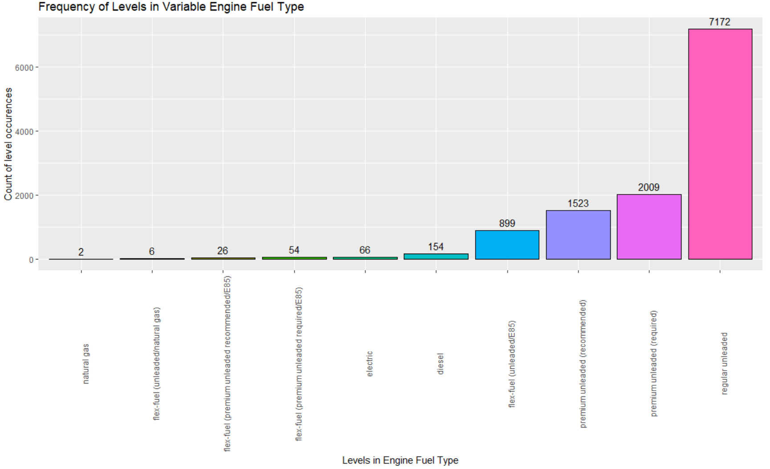
Figure 4: Count plot of Engine Fuel Type before data cleaning

Slide 9
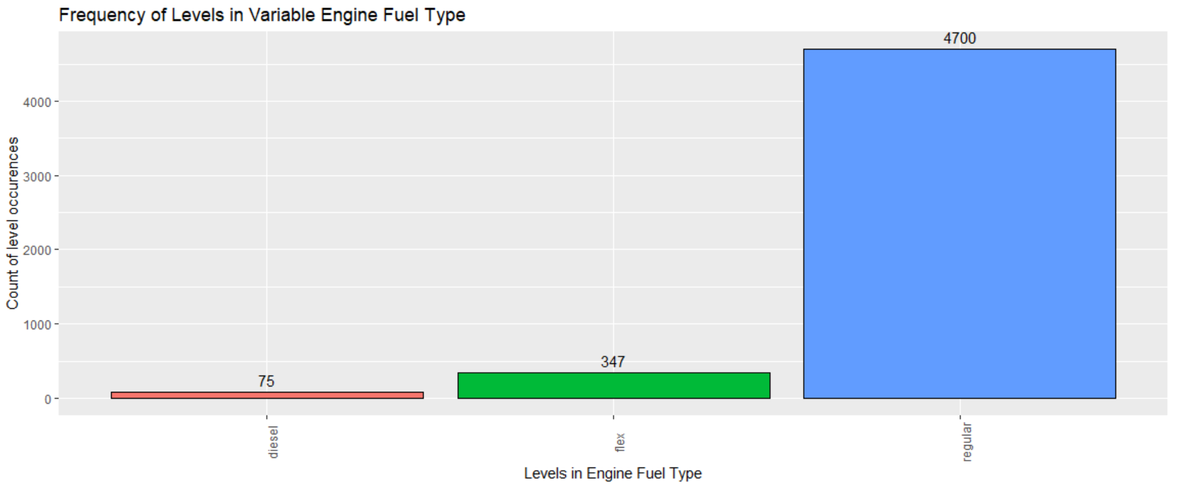
Figure 5: Count plot of Engine Fuel Type after data cleaning

Slide 10
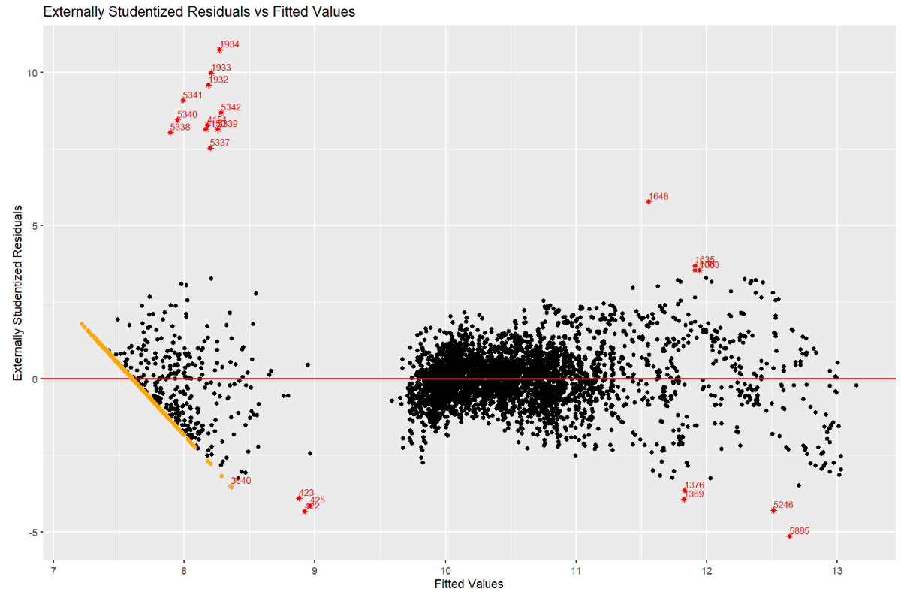
Figure 6: Examining errors of a preliminary model

Slide 11
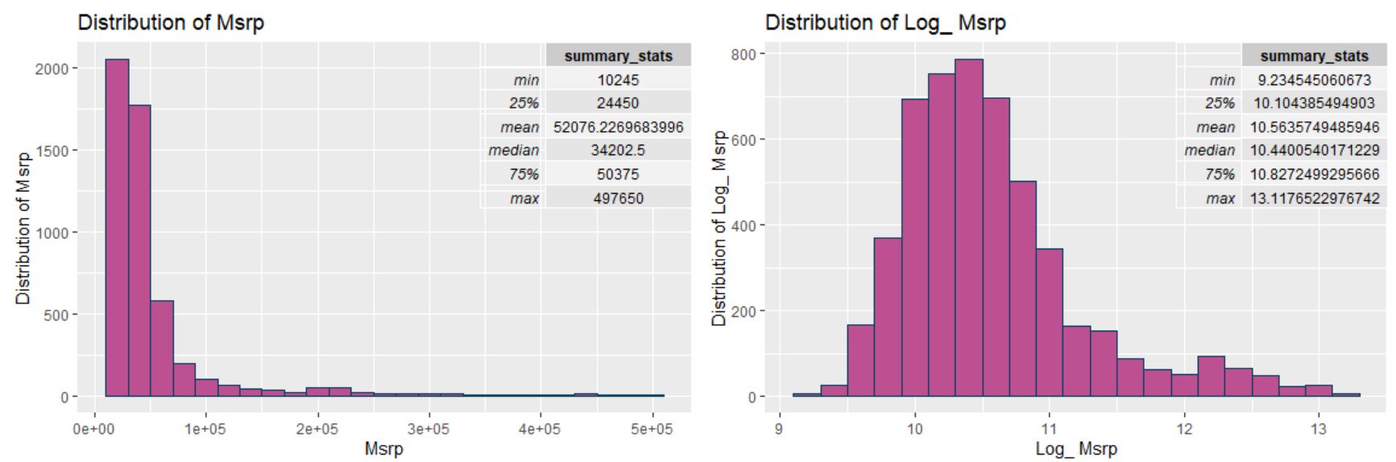
Figure 7: MSRP and log transformed version after data cleaning

Slide 12
Table 5
 | Complex Model | Simple Model | Metric % Increase | Metric % Decrease
Predictor count | 18 | 10 | --------- | ---------
PRESS | 148.9296 | 160.6880 | 7.8952671 | ---------
Prediction R-squared | 0.9266009 | 0.9208059 | --------- | 0.62540990
AIC | -2751.4896 | -2400.0299 | 12.773434 | ---------
BIC | -2545.5451 | -2252.0073 | 11.531432 | ---------
RMSE | 0.1796673 | 0.1866432 | 3.8826651 | ---------
R-squared | 0.9268817 | 0.9211328 | --------- | 0.6202451
MAE | 0.1335809 | 0.1375110 | 2.9421053 | ---------
Final Test RMSE | 0.1887110 | 0.1981315 | 4.992043 | ---------
Final Test R-Squared | 0.9246883 | 0.9173191 | --------- | 0.796937
Final Test MAE | 0.1407426 | 0.1459255 | 3.682588 | ---------
Metric Type Legend
Leave-one-out metrics
Probabilistic methods
Repeated 10-fold cross-validation metrics (repeats=20)
Final Test Set Metrics
Complex model predictors:
Age highway_MPG Engine_Cylinders Engine_HP Transmission_Type Number_of_Doors Vehicle_Style Vehicle_Size Driven_Wheels Factory_Tuner Performance Luxury Flex_Fuel Hatchback Hybrid Diesel Exotic Popularity
Simpler Model Predictors:
Age Engine_Cylinders Engine_HP Transmission_Type Vehicle_Style Driven_Wheels Luxury Hybrid Diesel Exotic

Slide 13
Table 6
 | Complex Model | Complex Model with Popularity Removed | Metric Percent Increase | Metric Percent Decrease
Predictor count | 18 | 17 | --------- | ---------
Final Test RMSE | 0.1887110 | 0.1894909 | 0.413322 | ---------
Final Test R-Squared | 0.9246883 | 0.9240666 | --------- | 0.06723636
Final Test MAE | 0.1407426 | 0.1413308 | 0.417942 | ---------
Comparing the complex models test set performance with and without the popularity variable

Slide 14
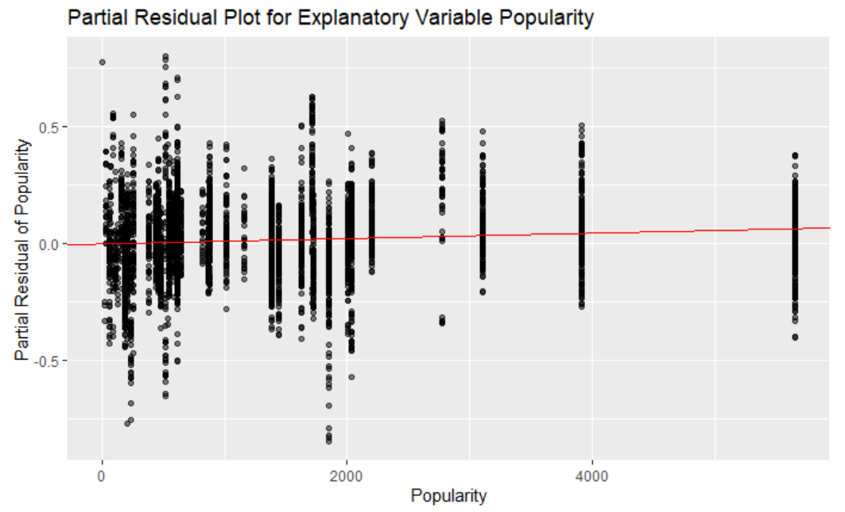
Figure 8: Partial residual plot with respect to the Popularity attribute, for a complex model containing 18 predictors. (All predictors included in the model are shown in Table 7 on the next slide)

Slide 15
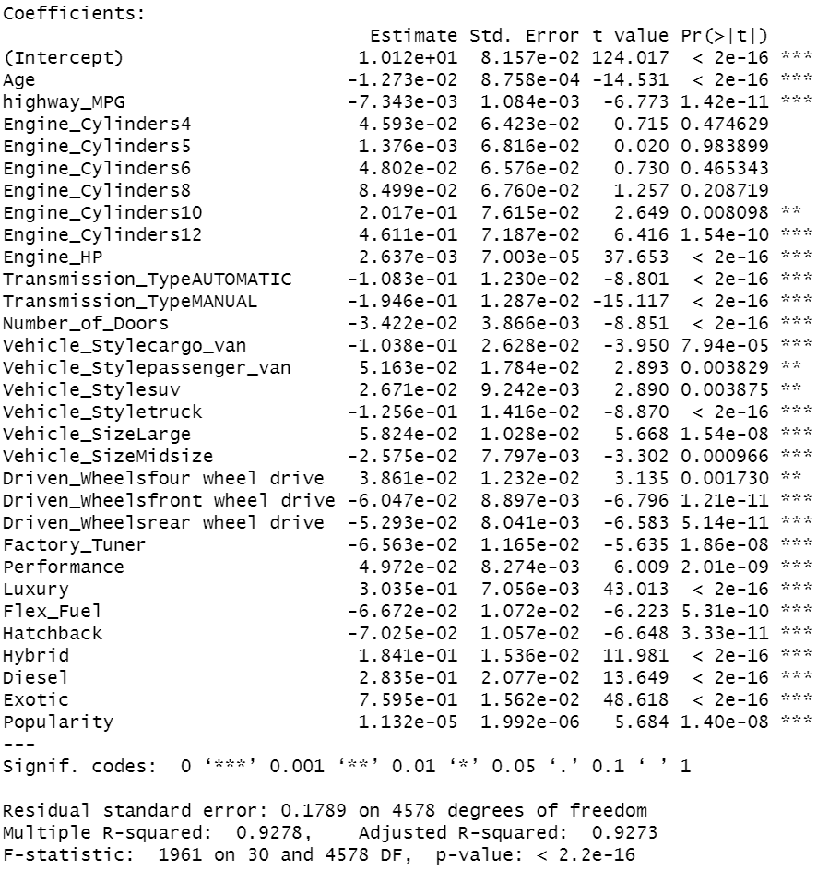
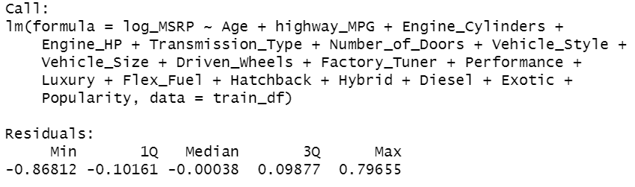
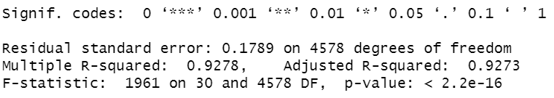
Table 7
Summary of the complex model containing 18 predictors. This model is also analyzed in Table 5 and Table 6.

Slide 16
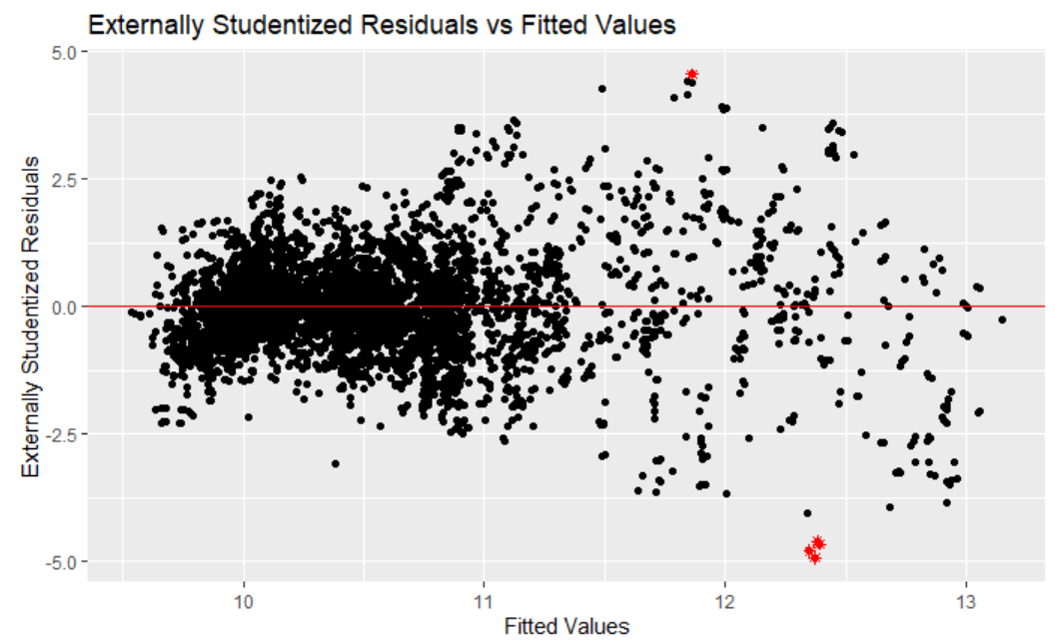
Figure 9: Plot of externally studentized residuals for the 10 predictor model. Points have a residual value that is 4.5 standard deviations or more away from the mean. The cluster of red points at the bottom of the screen are observations 4320, 4842, 4844 and 4843

Slide 17
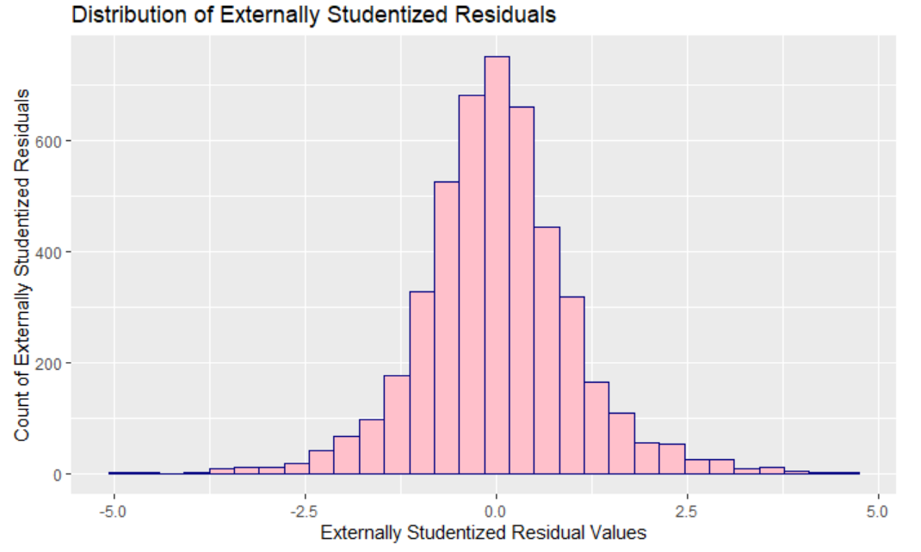
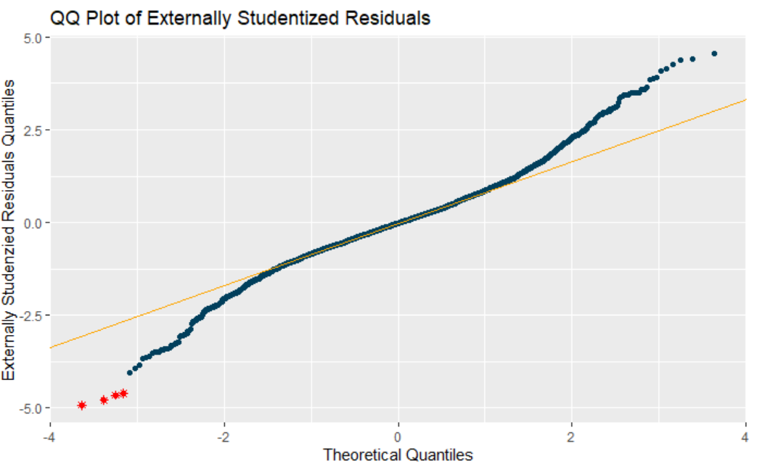
Figure 10: Histogram of the externally studentized residuals for the 10 predictor model discussed in Table 5.
Figure 11: QQ-Plot of the externally studentized residual for the 10 predictor model discussed in Table 5. The 4 points flagged in red are those with the 4 largest residuals, and correspond to the observations shown in Table 8.

Slide 18
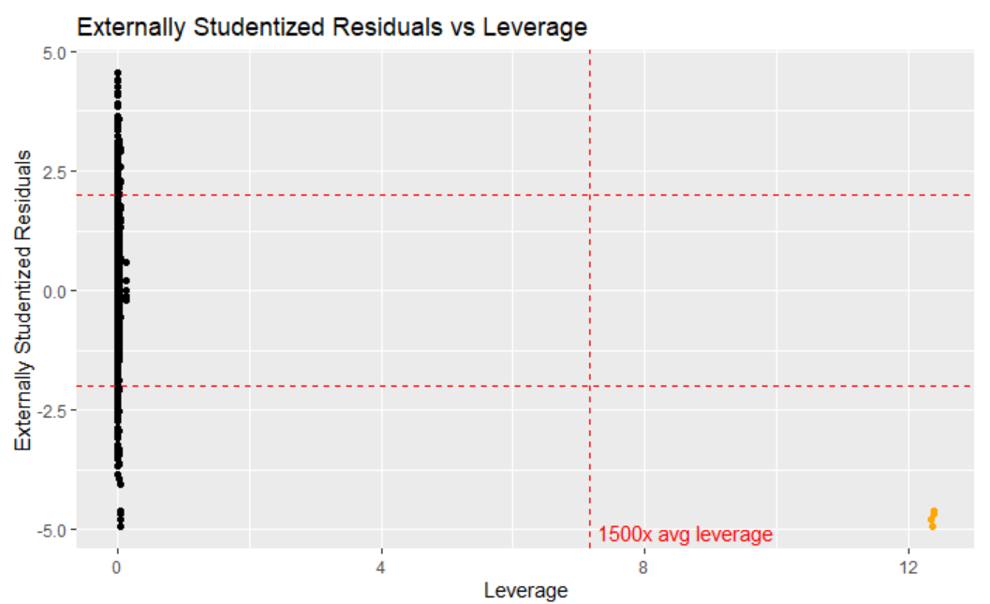
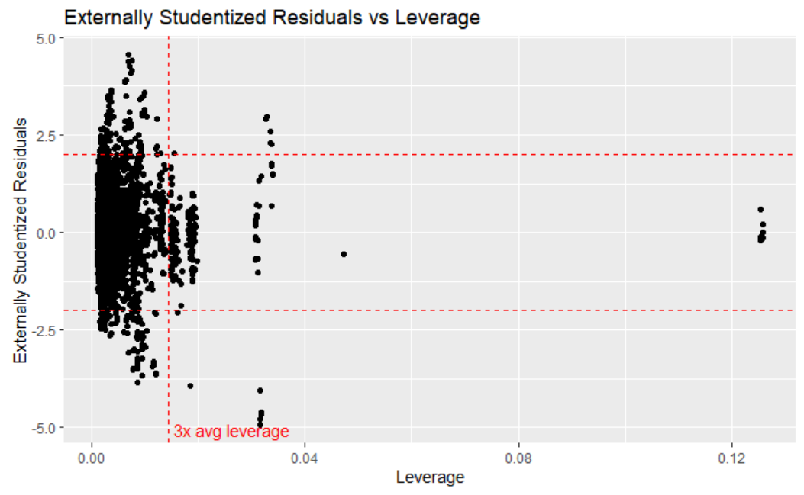
Figure 12: Residual vs Leverage for 10 predictor model, yellow markers are observations 4320, 4842, 4844 and 4843. These points have about 2500x the average leverage.
Figure 13: Residual vs Leverage for 10 predictor model, again, this time zoomed in to get a better view of the rest of the data (observations 4320, 4842, 4844 off screen to the right).

Slide 19
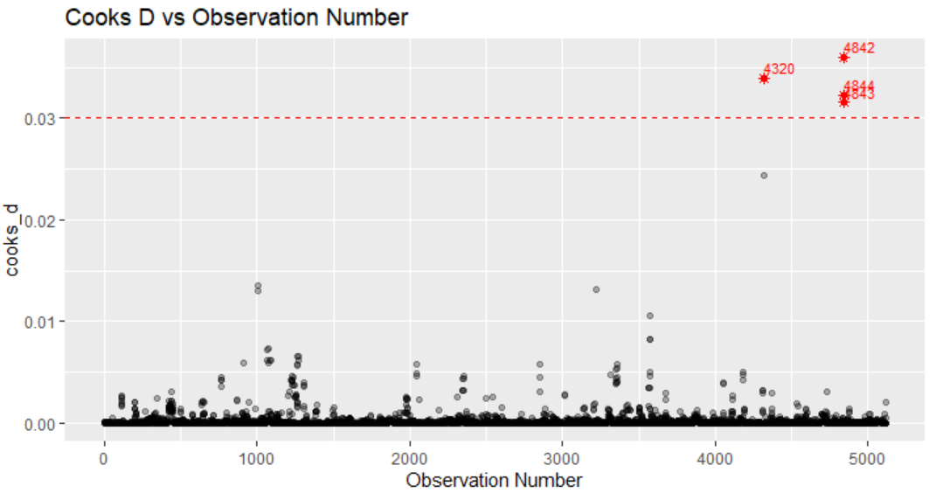
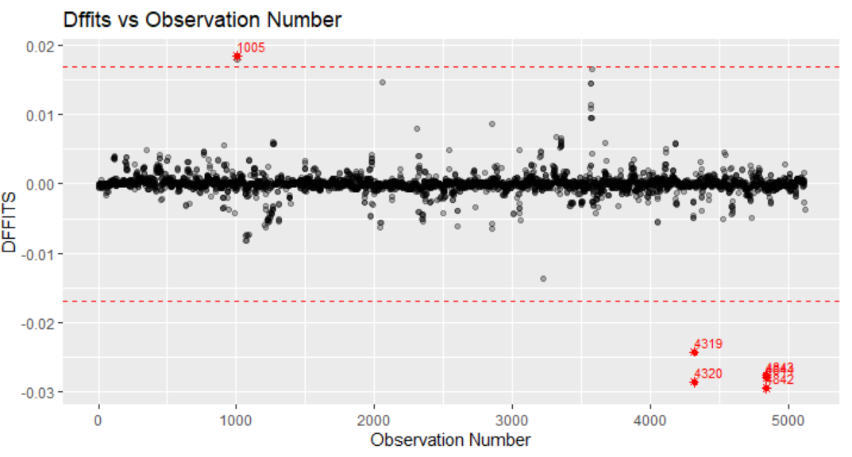
Figure 14: Cooks D vs Observation number for the 10 predictor model
Figure 15: DFFITS vs observation number for the 10 predictor model.

Slide 20



Table 8
Influential observations associated with the simpler, 10 predictor model discussed in Table 5

Slide 21

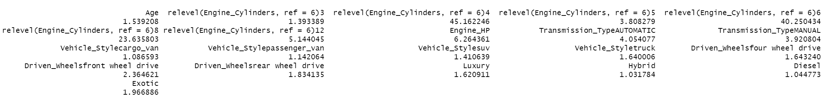
Figure 16: Variance inflation factors for the simple 10 predictor model discussed in Table 5. Note the high multicollinearity caused by the Engine Cylinders attribute. This issue is present in any model that utilizes Engine Cylinders.
Figure 17: Variance inflation factors for the same model as shown in Figure 16, after simply changing the reference level associated with the Engine Cylinders factor. This is an instance of multicollinearity being caused by too few observations existing in the reference level, and is one of the few situations where the presence of multicollinearity is not a huge concern. This is described in detail by Dr. Allison from University of Pennsylvania here

Slide 22
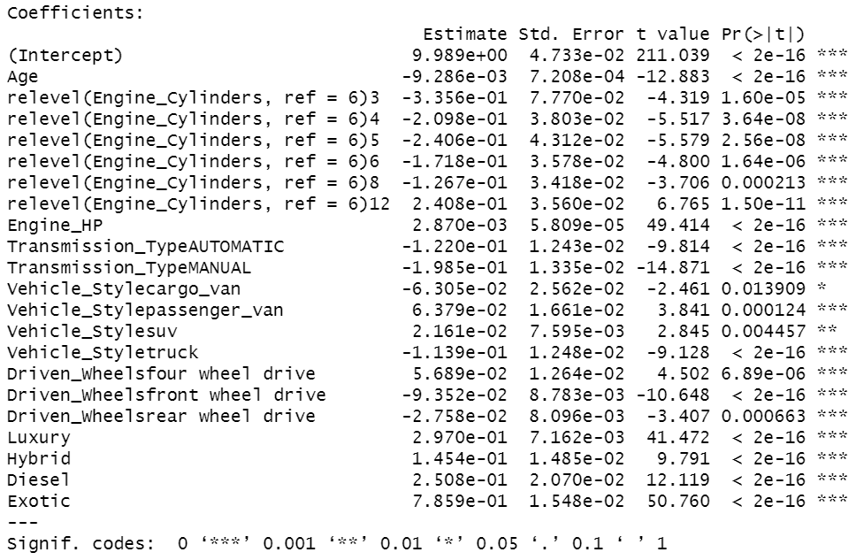
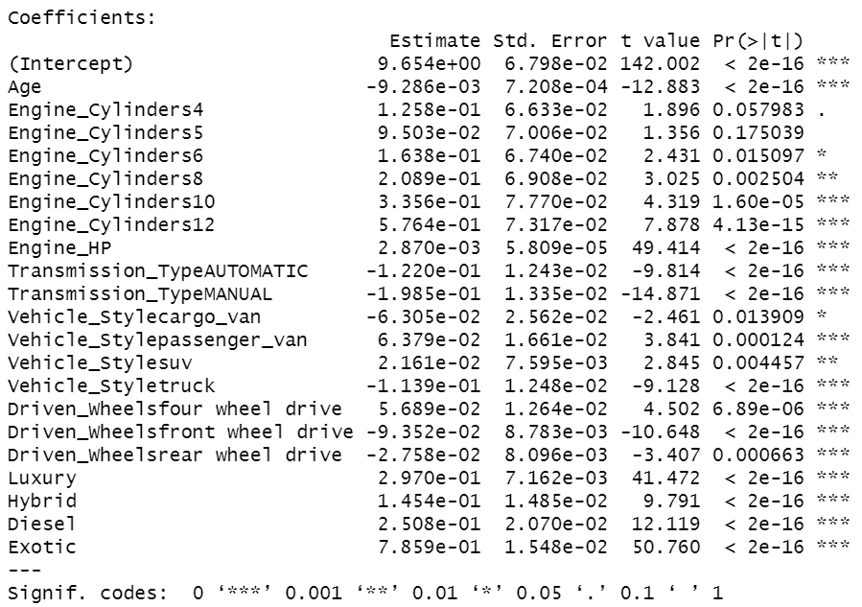
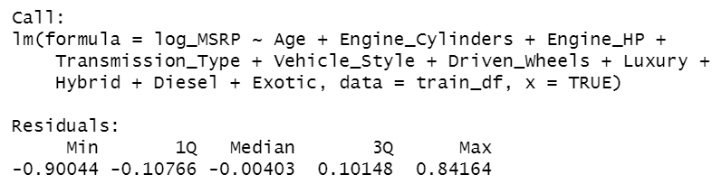
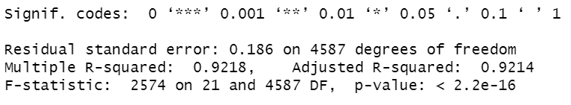
Table 9
Same model summary as shown on the left, with the only modification being to the reference level of the Engine Cylinders factor. This is provided as and aid to the discussion on multicollinearity being caused by using a factor level with a small number of observations as the reference category in a linear regression.
Summary of the simpler model containing 10 predictors. This model is also analyzed in Table 5.

Slide 23
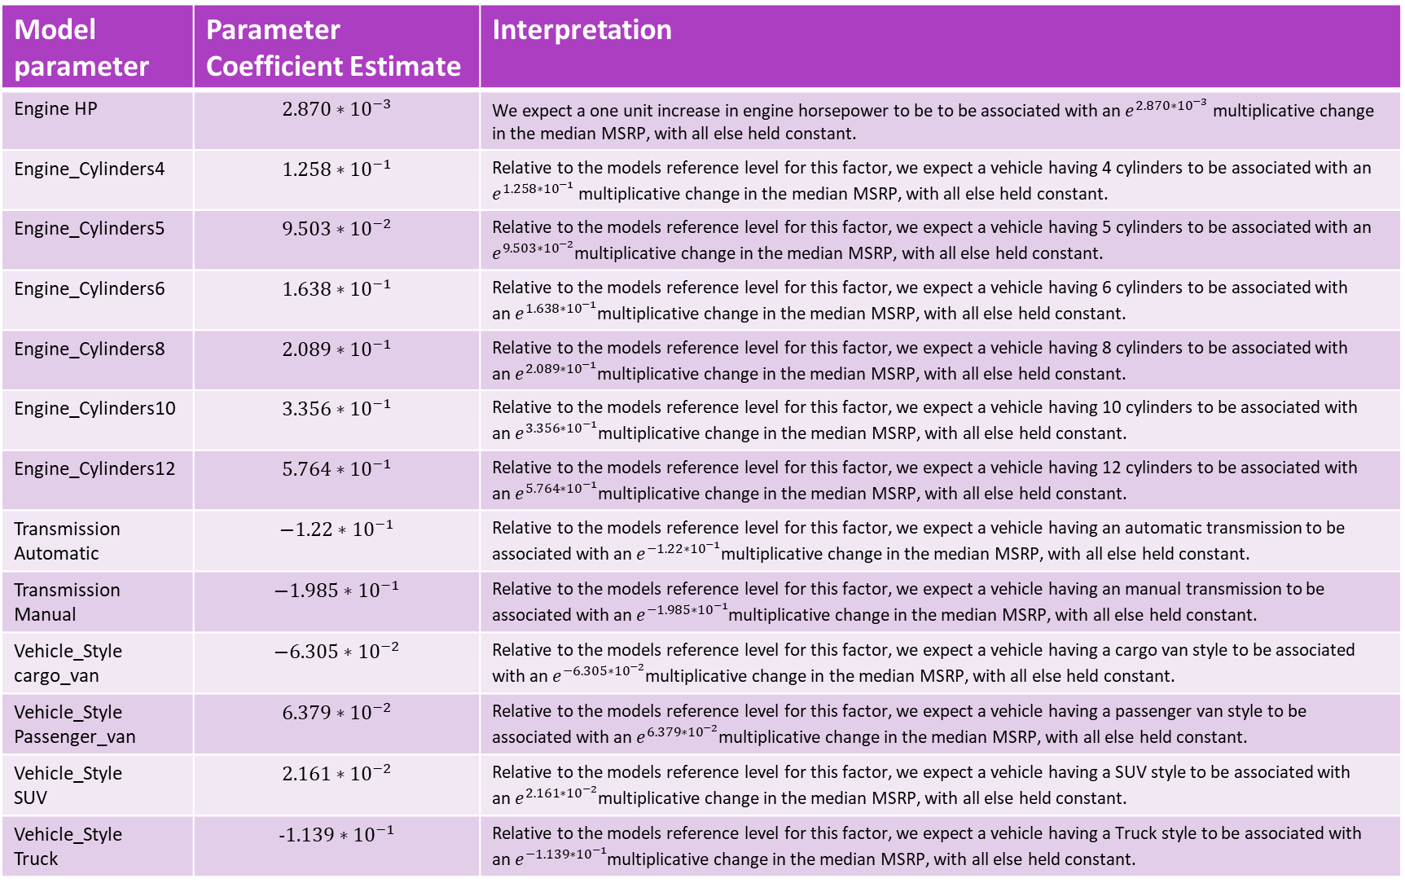
Table 10
Model parameter | Parameter Coefficient Estimate | Interpretation
Engine HP | $$2.870∗{10}^{−3}$$ | We expect a one unit increase in engine horsepower to be to be associated with an $e^{2.870∗{10}^{−3}}$ multiplicative change in the median MSRP, with all else held constant.
Engine_Cylinders4 | $$1.258∗{10}^{−1}$$ | Relative to the models reference level for this factor, we expect a vehicle having 4 cylinders to be associated with an $e^{1.258∗{10}^{−1}}$ multiplicative change in the median MSRP, with all else held constant.
Engine_Cylinders5 | $$9.503∗{10}^{−2}$$ | Relative to the models reference level for this factor, we expect a vehicle having 5 cylinders to be associated with an $e^{9.503∗{10}^{−2}}$multiplicative change in the median MSRP, with all else held constant.
Engine_Cylinders6 | $$1.638∗{10}^{−1}$$ | Relative to the models reference level for this factor, we expect a vehicle having 6 cylinders to be associated with an$e^{1.638∗{10}^{−1}}$multiplicative change in the median MSRP, with all else held constant.
Engine_Cylinders8 | $$2.089∗{10}^{−1}$$ | Relative to the models reference level for this factor, we expect a vehicle having 8 cylinders to be associated with an$e^{2.089∗{10}^{−1}}$multiplicative change in the median MSRP, with all else held constant.
Engine_Cylinders10 | $$3.356∗{10}^{−1}$$ | Relative to the models reference level for this factor, we expect a vehicle having 10 cylinders to be associated with an$e^{3.356∗{10}^{−1}}$multiplicative change in the median MSRP, with all else held constant.
Engine_Cylinders12 | $$5.764∗{10}^{−1}$$ | Relative to the models reference level for this factor, we expect a vehicle having 12 cylinders to be associated with an$e^{5.764∗{10}^{−1}}$multiplicative change in the median MSRP, with all else held constant.
Transmission Automatic | $$−1.22∗{10}^{−1}$$ | Relative to the models reference level for this factor, we expect a vehicle having an automatic transmission to be associated with an$e^{−1.22∗{10}^{−1}}$multiplicative change in the median MSRP, with all else held constant.
Transmission Manual | $$−1.985∗{10}^{−1}$$ | Relative to the models reference level for this factor, we expect a vehicle having an manual transmission to be associated with an$e^{−1.985∗{10}^{−1}}$multiplicative change in the median MSRP, with all else held constant.
Vehicle_Style cargo_van | $$−6.305∗{10}^{−2}$$ | Relative to the models reference level for this factor, we expect a vehicle having a cargo van style to be associated with an$e^{−6.305∗{10}^{−2}}$multiplicative change in the median MSRP, with all else held constant.
Vehicle_Style Passenger_van | $$6.379∗{10}^{−2}$$ | Relative to the models reference level for this factor, we expect a vehicle having a passenger van style to be associated with an$e^{6.379∗{10}^{−2}}$multiplicative change in the median MSRP, with all else held constant.
Vehicle_Style SUV | $$2.161∗{10}^{−2}$$ | Relative to the models reference level for this factor, we expect a vehicle having a SUV style to be associated with an$e^{2.161∗{10}^{−2}}$multiplicative change in the median MSRP, with all else held constant.
Vehicle_Style Truck | $$-1.139∗{10}^{−1}$$ | Relative to the models reference level for this factor, we expect a vehicle having a Truck style to be associated with an$e^{−1.139∗{10}^{−1}}$multiplicative change in the median MSRP, with all else held constant.

Slide 24
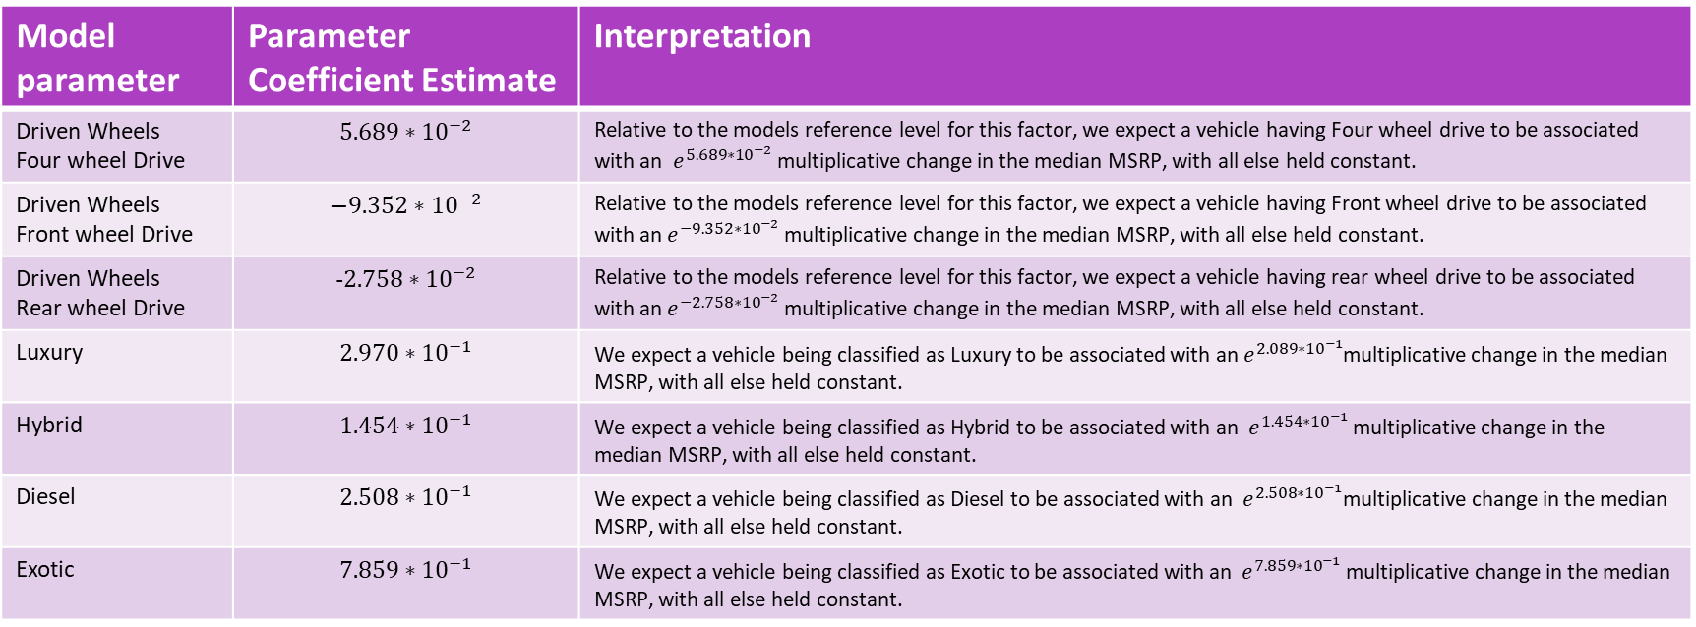
Table 10 continued
Model parameter | Parameter Coefficient Estimate | Interpretation
Driven Wheels Four wheel Drive | $$5.689∗{10}^{−2}$$ | Relative to the models reference level for this factor, we expect a vehicle having Four wheel drive to be associated with an $e^{5.689∗{10}^{−2}}$ multiplicative change in the median MSRP, with all else held constant.
Driven Wheels Front wheel Drive | $$−9.352∗{10}^{−2}$$ | Relative to the models reference level for this factor, we expect a vehicle having Front wheel drive to be associated with an $e^{−9.352∗{10}^{−2} }$multiplicative change in the median MSRP, with all else held constant.
Driven Wheels Rear wheel Drive | $$-2.758∗{10}^{−2}$$ | Relative to the models reference level for this factor, we expect a vehicle having rear wheel drive to be associated with an$e^{−2.758∗{10}^{−2} }$multiplicative change in the median MSRP, with all else held constant.
Luxury | $$2.970∗{10}^{−1}$$ | We expect a vehicle being classified as Luxury to be associated with an$e^{2.089∗{10}^{−1}}$multiplicative change in the median MSRP, with all else held constant.
Hybrid | $$1.454∗{10}^{−1}$$ | We expect a vehicle being classified as Hybrid to be associated with an$e^{1.454∗{10}^{−1} }$multiplicative change in the median MSRP, with all else held constant.
Diesel | $$2.508∗{10}^{−1}$$ | We expect a vehicle being classified as Diesel to be associated with an$e^{2.508∗{10}^{−1}}$multiplicative change in the median MSRP, with all else held constant.
Exotic | $$7.859∗{10}^{−1}$$ | We expect a vehicle being classified as Exotic to be associated with an$e^{7.859∗{10}^{−1} }$multiplicative change in the median MSRP, with all else held constant.

Slide 25
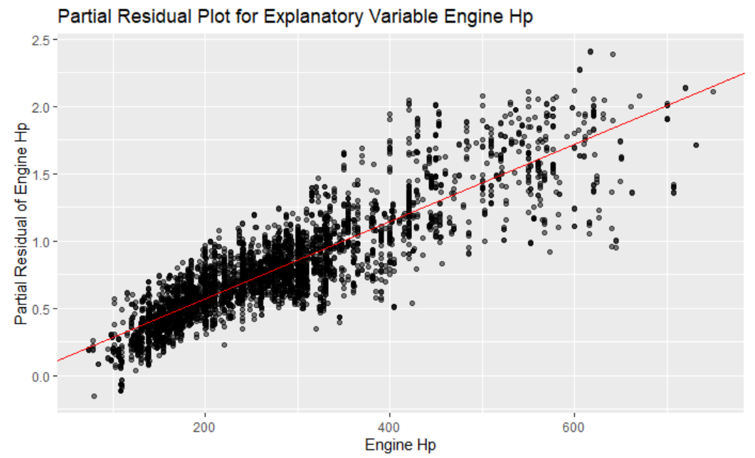
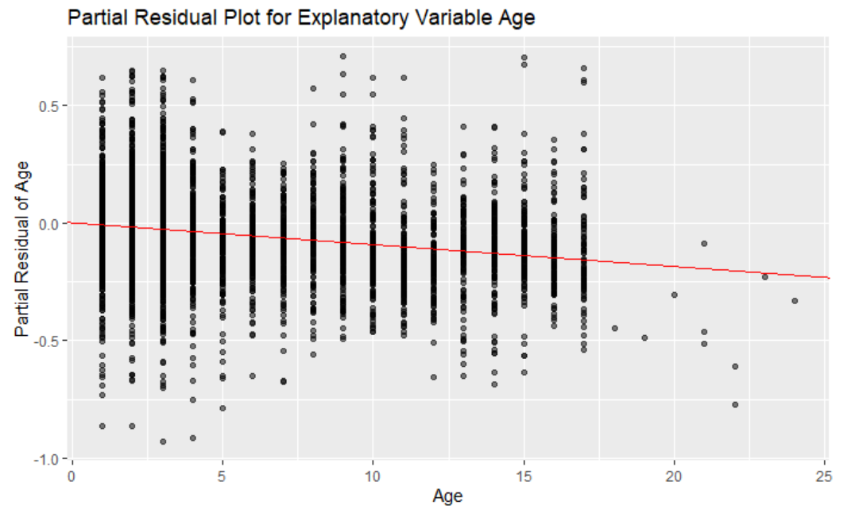
Figure 18: Partial residual plot with respect to Engine HP, for the 10 predictor model shown in Table 5.
Figure 19: Partial residual plot with respect to Age, for the 10 predictor model shown in Table 5.

Slide 26
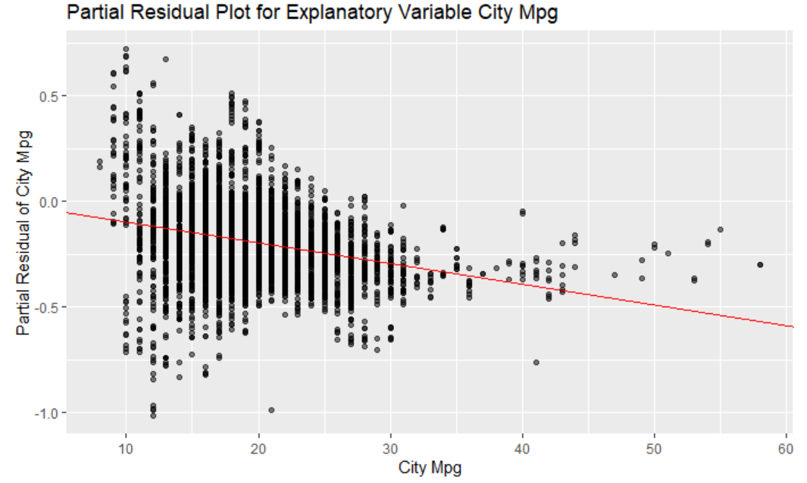
Figure 20: Partial residual plot with respect to City MPG, after adding the City MPG predictor to the 10 predictor model shown in Table 5.

Slide 27
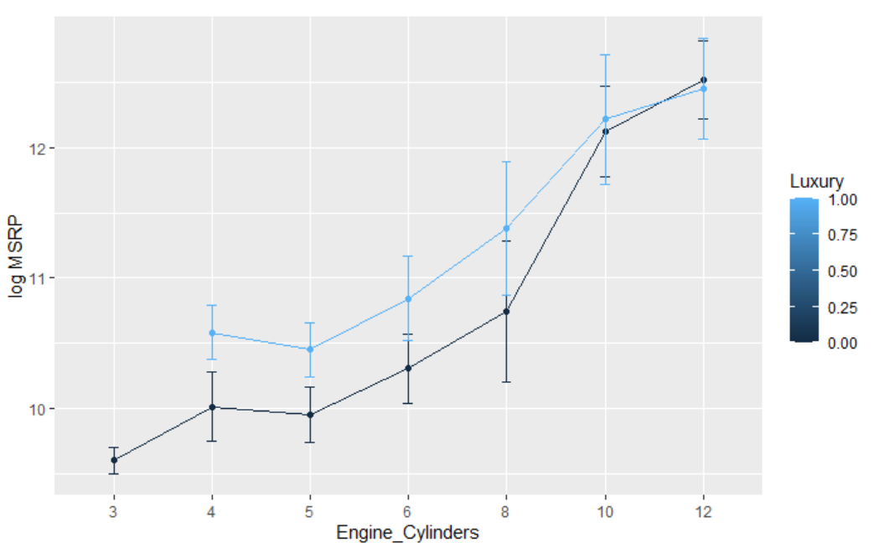
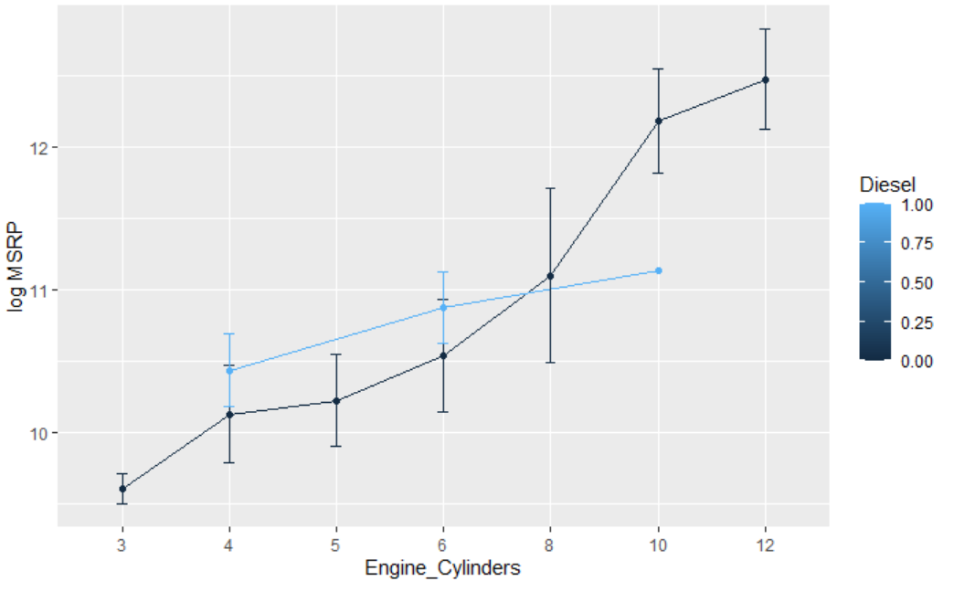
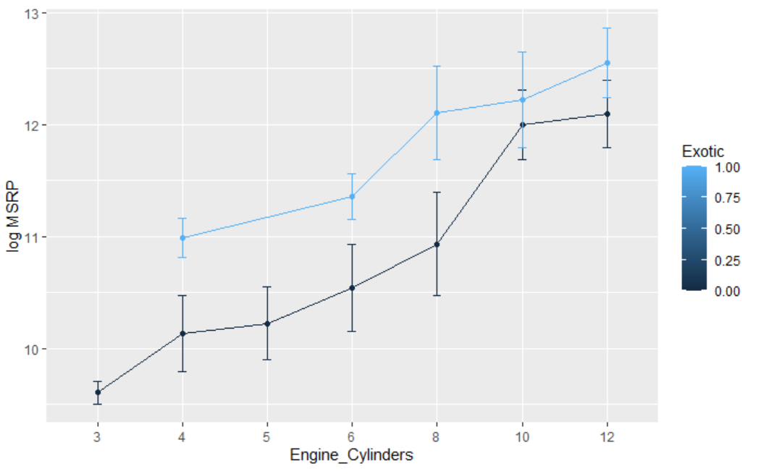
Figure 21: Means plot showing how the change in response associated with a change in Engine Cylinder levels differs based on the level of the Luxury factor.
Figure 22: Means plot showing how the change in response associated with a change in Engine Cylinder levels differs on the level of the Diesel factor.
Figure 23: Means plot showing how the change in response associated with a change in Engine Cylinder levels depends on the level of the Exotic factor.

Slide 28
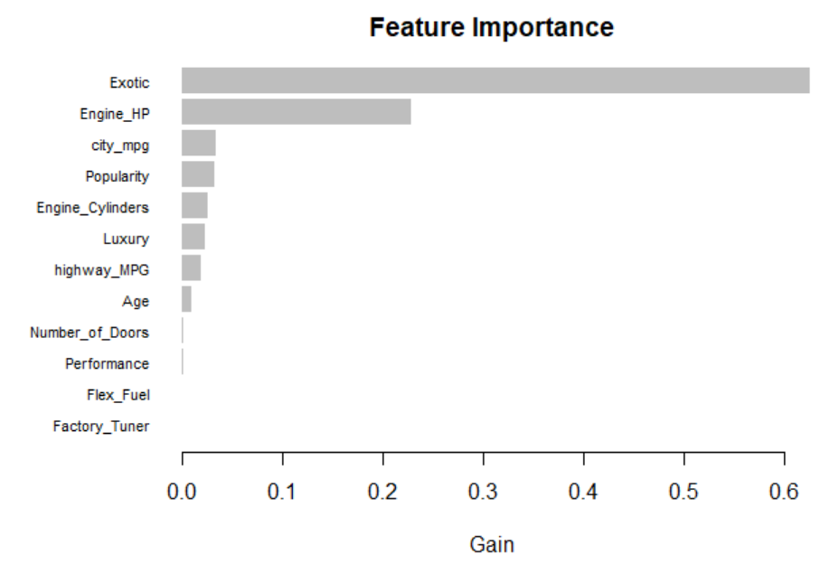
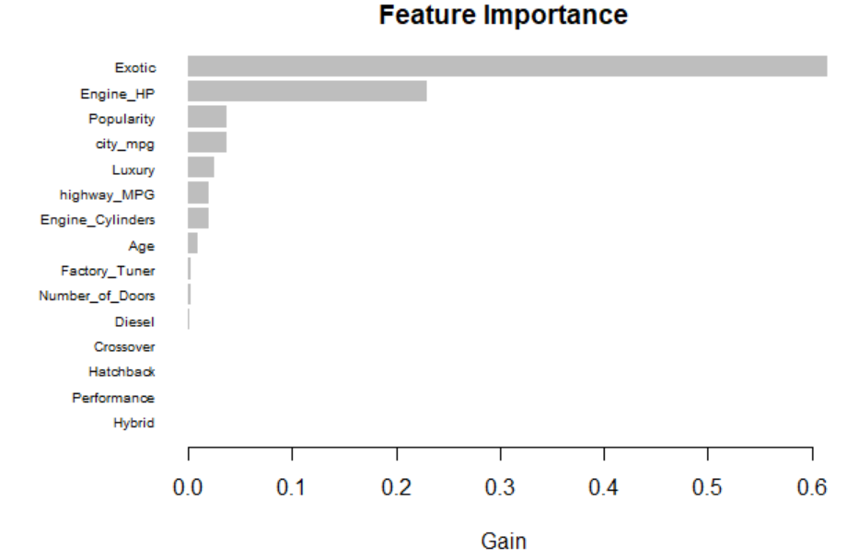
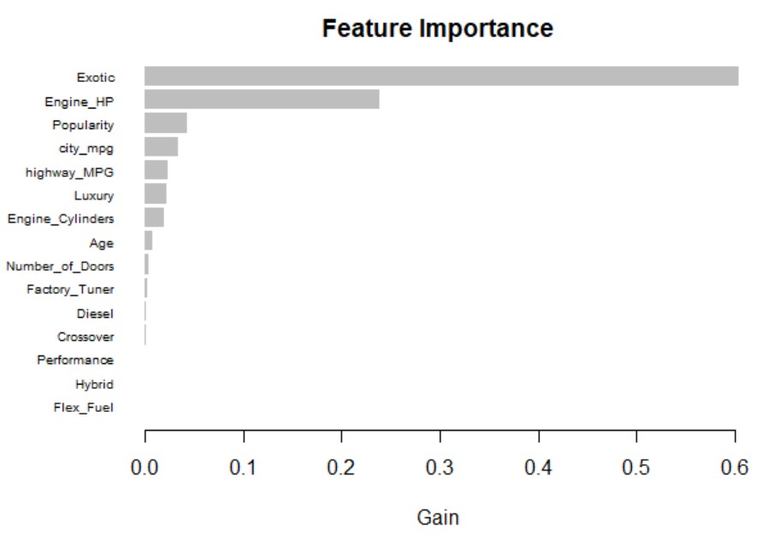
Figure 23: Random Forest Feature Importance.
Figure 25: DART Feature Importance.
Figure 24: Gradient Boosted Decision Trees feature importance.

Slide 29
Table 11
Model | Cross Validation RMSE | Final Test Set RMSE
Simple Regression Model | 0.1866432 | 0.1981315
Complex Regression Model | 0.1777650 | 0.1835966
Random Forest | 13108.62 | 14069.34
Gradient Boosted Decision Trees | 9036 | 9381.721
DART | 10693.05 | 9692.89
Final model comparisons. Note that the metrics for the two linear regression models are on a log-scale, where as the metrics for the tree-based models are in the original units (dollars).

Slide 30
Back-up slides

Slide 31
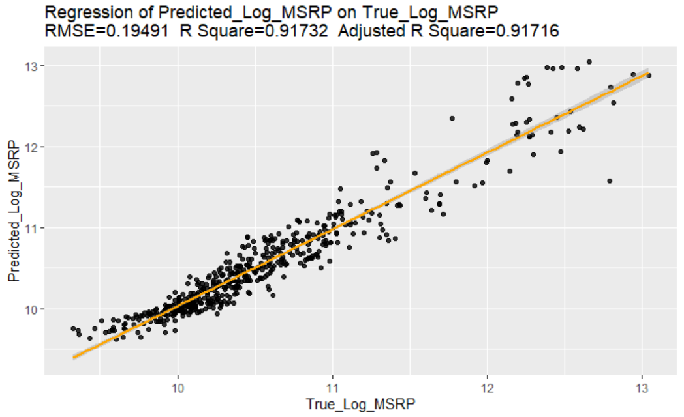
Figure x: Predicted values vs Actual values for the relatively simple 10 predictor model discussed in Table 5

Slide 32
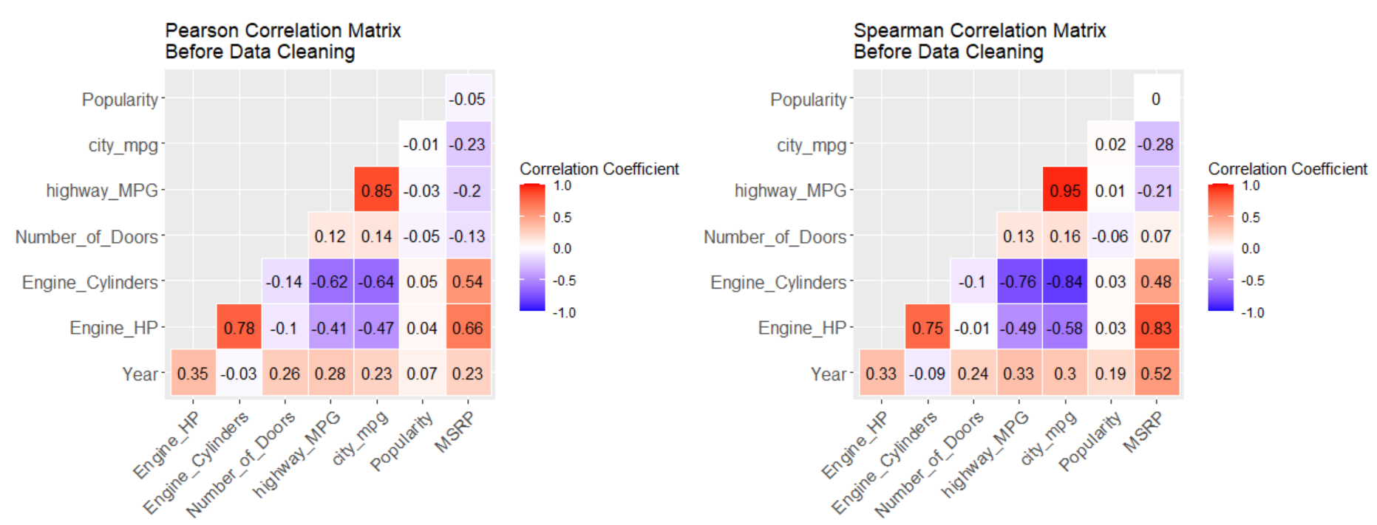
Figure XX: Correlations before data cleaning

Slide 33
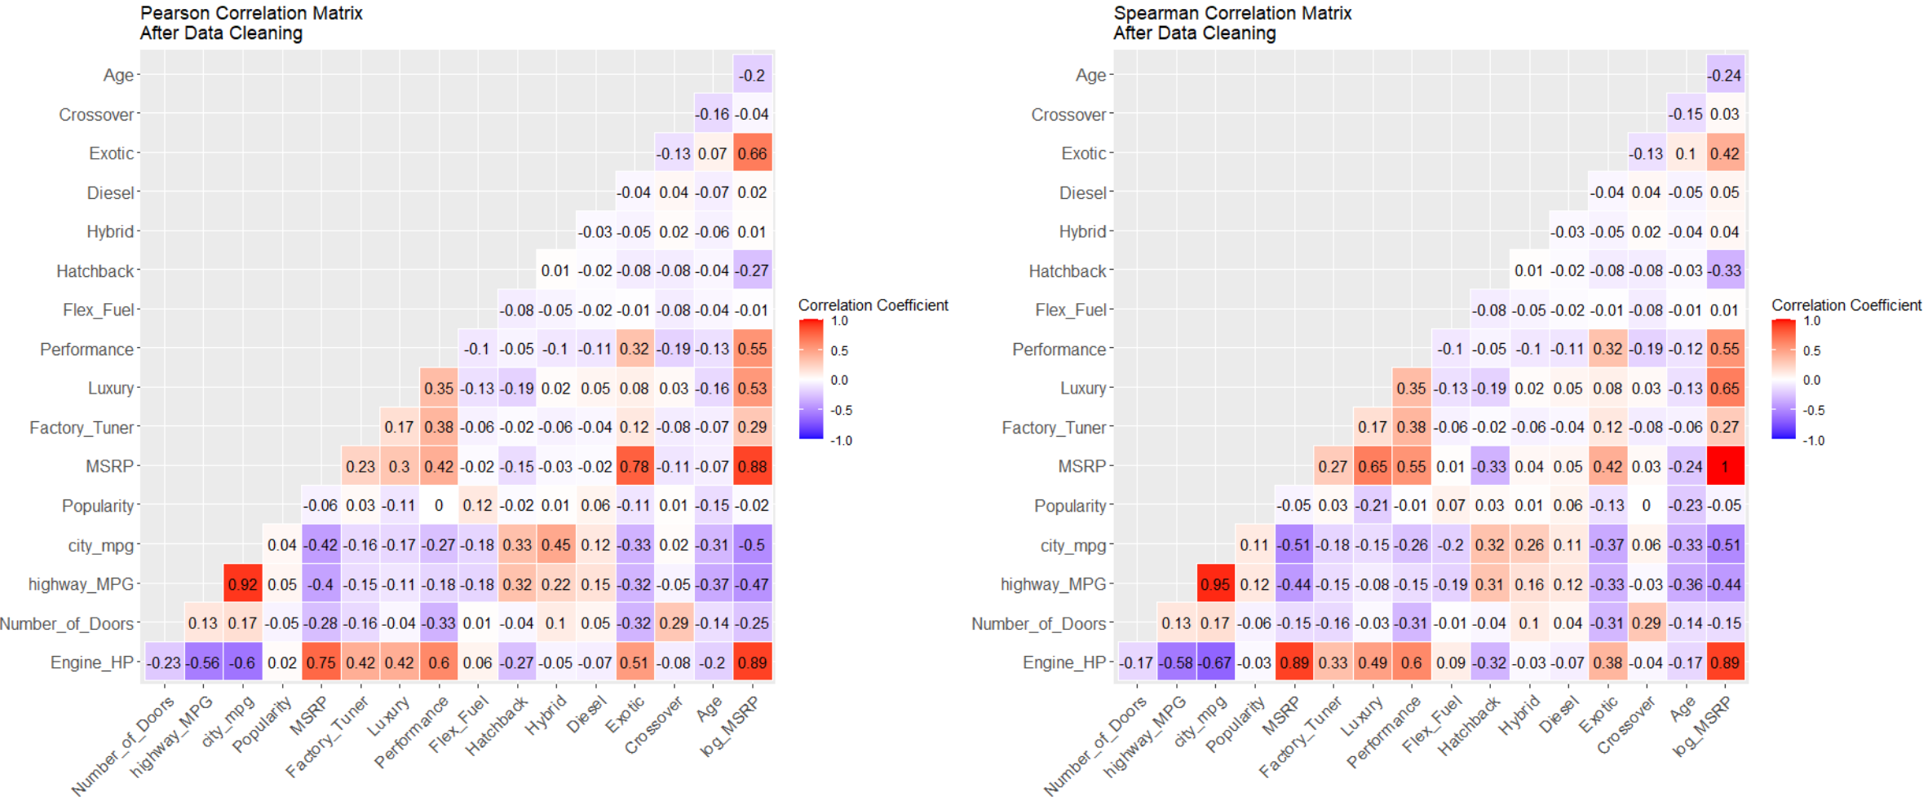
Figure XX: Correlations after data cleaning

